Slide 1
Data Transformation
Session 4
Patrick Mathias
September 26, 2021
Notes:
In this session we'll begin to tackle one of the fundamental issues in data analysis and that is the process of transforming, or wrangling, your data set.

Slide 2
September 26, 2021 | Session | Instructor
8:30 am - 8:45 am | Course Introduction | Patrick Mathias
8:45 am – 9:30 am | Intro to R and Reproducible Reporting | Joseph Rudolf
9:45 am - 10:30 am | Coding Basics and Importing Data | Joseph Rudolf
10:45 am – 11:30 am | Data Visualization | Patrick Mathias
LUNCH
12:30 pm - 1:30 pm | Data Transformation | Patrick Mathias
1:45 pm – 2:45 pm | Grouping and Summarizing Data | Joseph Rudolf
3:00 pm - 3:30 pm | Dashboard Demo and Course Wrap Up | Patrick Mathias

Slide 3
Goals
Learn how to use dplyr to transform data frames
Appreciate the role of piping in facilitating data transformation
Objectives
List the major forms of data transformation implemented in dplyr
Extract columns meeting inclusion criteria from a data frame
Create new calculated columns not found in the original data frame
Use the pipe operator to pass the output of one function as an input to the next function
Notes:
Our goals for this session are to learn to use some of the functions in the dplyr package to tackle some of the most common challenges in data transformation. In addition we'll be using a special tool called a pipe operator to string together individual functions into a data analysis pipeline.

Slide 4
Typical Data Science Pipeline
Tidy
Transform
Notes:
This is the generalized data science pipeline that was introduced to you yesterday. The functions we'll be learning about fit specifically in the "tidy" and "transform" portions of this workflow.

Slide 5


What is a “Tidy” Data Frame
A data set is tidy if:
Each variable is in its own column
Each observation is in its own row
Each value is in its own cell
MRN
Notes:
So let's quickly review what we mean by a tidy dataset. By definition it essentially describes a data set in which
→ variables or features are recorded in columns
→ Each row represents a single observation
→ And finally each cell contains only one value.
This is admittedly somewhat abstract. The way that I think about it is that a tidy data set is one that is at the point where it is cleaned up and ready to be analyzed either using statistical analysis or through a visualization.
The opposite is a messy data frame which is generally how data comes at us in the real world. Its basically in a form that makes it difficult or impossible to analyze without processing.

Slide 6

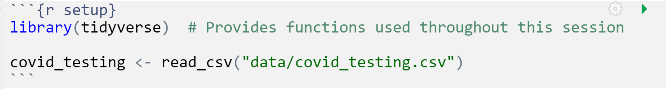
Your Turn 1
Open "04-Transform.Rmd" Run the setup chunk
Notes:
Let's start the session with a Your Turn. Let's head on over to the Cloud Rstudio instance and open the R markdown file called 04-Transform.Rmd and load the covid testing dataset.
(in Rstudio)
This can be done by going to the lower right pane under the "file" tab, navigating to the exercises folder and selecting the 04-Transform.Rmd file.
After that go to the first code chunk which is called "setup" and press the play button

Slide 7
Pop Quiz
How can you confirm that you have successfully loaded the data file into RStudio?
1. The code that imported the data did not yield an error
2. Code that references the covid_testing object runs without errors
3. The covid_testing object is present in the environment pane
4. All of the above
Notes:
And as a quick followup how can you tell that you were successful in loading the covid_testing data set into memory\, and you have 4 choices:
1 The code that imported the data set didn’t yield an error
2 code that references the covid_testing data set runs without an error
3. You can see the covid_testing object in your environment pane
Or 4 all of the above.
Put your answer in the chat window

Slide 8

Transform Data with
Notes:
In this session we'll be using functions that are part of the dplyr package. The dplyr package is a workhorse for data transformation and since its part of the tidyverse meta-package you just loaded it with the code chunk from the Your Turn.

Slide 9
dplyr
dplyr implements a grammar of data manipulation for transforming tabular data.
Notes:
Now dplyr isn't just a haphazard collection of functions. It takes a holistic almost philosophical approach to the transformation of data and implements it in an organized lexicon or grammar for programmatically transforming data.
What I mean when I say a grammar for transforming data really relates to 2 characteristics of the dplyr approach.
#1 In a similar way to how verbs operate on nouns, dplyr functions operate on data frames.
#2 Dplyr functions use a consistent syntax which minimizes cognitive load so once you understand the dplyr approach with one function, it's easier to learn new functions in dplyr.

Slide 10
dplyr: a grammar for transforming data
1
Choose columns.
select()
2
Extract rows.
filter()
3
Derive new columns.
mutate()
4
summarize()
Change the unit of analysis.
Notes:
This session is about getting to know these functions. Data wrangling can require a lot of different manipulations and dplyr has a wealth of functions to help you with this, but most data wrangling in my experience will involve one of these four actions
Starting with the raw data, youll need to choose the columns you want, define and extract the rows of interest, you will likely need to derive new calculated columns and finally often we have to aggregate data with a summary.
→
Dplyr implements four functions that handle each of these actions, Select, Filter, Mutate, and Summarize. In this session we'll be discussing the first 3, and the last one will be covered in the next one.

Slide 11
Dplyr Approach
ƒ(
)
Notes:
Another feature of the dplyr approach to data manipulation is that each function in the package is tuned to do one thing, meaning to change the data in one way.
What this means is that if you have several changes you need to make to the dataset - you won't be applying one function to get it to the end result as you see on this slide.

Slide 12
Dplyr Approach
ƒ(
)
ƒ(
)
4 columns x 7 rows
6 columns x 11 rows
ƒ(
)
5 columns x 7 rows
4 columns x 11 rows
Notes:
Rather a typical workflow involves making one tweak to the data at a time, going through a sequence of steps, each one carried out by one function to get you to the final tidy dataset.

Slide 13
Common syntax
Each function takes a data frame as its first argument and returns a data frame as its output.
function(data, ...)
dplyr function
data frame to transform
specific arguments
13
Notes:
One of the major advantages of using dplyr functions in your data analysis is that dplyr functions all use a common syntax, which makes them easier to learn.
Each one will take a data frame as the first argument, which will be followed by additional arguments that basically serve as instructions to the function on how to operate on the data frame. The output of dplyr functions is always another data frame.

Slide 14
Filtering a Subset of Rows
Notes:
The first set of functions we will explore will be ones whose primary goal is to extracting the data of interest from a large and often messy pile of data.
Reducing a dataset to a narrow subset of columns and rows is often the first step in an analysis.

Slide 15
filter()
Extract rows that meet logical criteria
↓ Number of rows
= Number of Columns
Notes:
Here you see the graphical framework for how filter works. You provide the raw data as the input in the form of a data frame.
Filter will use logical criteria that you provide in the function, to identify the rows that are required
In the output, you will wind up with all the columns that you started with and just the rows defined in the filter function.

Slide 16
Common syntax
Each function takes a data frame as its first argument and returns a data frame as its output.
function(data, ...)
dplyr function
data frame to transform
specific arguments
Notes:
Recall that all dplyr functions hew to a common syntax and filter is no exception →

Slide 17
filter()
Extract rows that meet logical criteria
filter(data,... )
one or more logical tests (filter returns each row for which the test is TRUE)
data frame to transform
 |  |  | FALSE
 |  |  | FALSE
 |  |  | TRUE
 |  |  | FALSE
 |  |  | TRUE
 |  |  | FALSE
Notes:
In filter the first argument again is a data frame from which we will be extracting rows.
Afterwards we can input one more logical tests. R then performs that logical test on each row of the dataset and returns all rows in which the logical test is TRUE. Rows for which the tests are TRUE are returned in the output as a data frame and the rest are removed.
The key point here is that the logical tests are evaluated row by row, one at a time, independently.

Slide 18
filter()
Extract rows that meet logical criteria
filter(data, column_name == criteria )
one or more logical tests (filter returns each row for which the test is TRUE)
 |  |  | FALSE
 |  |  | FALSE
 |  |  | TRUE
 |  |  | FALSE
 |  |  | TRUE
 |  |  | FALSE
Notes:
Let's zoom in for a second on those logical tests.
Generally speaking they will take this form.
There will be some column that contains the data you want to filter on, like the clinic name, or the patient MRN.
Then there will be a logical test, what you see here is equals, you can also have greater than, less than etc.
And then you have the criteria. Equal to what? Greater than what number?
OK let's see some real examples →

Slide 19
filter()
Extract rows that meet logical criteria
filter(covid_testing, mrn == 5000083)
mrn | first_name | last_name
5000876 | sarella | stark
5006017 | alester | stark
5001412 | jhezane | westerling
5000083 | lollys | clegane
mrn | first_name | last_name
5000083 | lollys | clegane
FALSE
5000876 | sarella | stark
FALSE
5006017 | alester | stark
FALSE
5001412 | jhezane | westerling
TRUE
Notes:
Here's an example. We supply the covid_testing data frame as the first argument. Afterwards we provide one logical test; we ask filter() to return rows in which the mrn is 5000083.
Filter will go row by row, starting from the very first row and ask is the value in the mrn column equal to 500083 for that row, as you can see it's not – so it gets an imaginary value of false. →
It then goes to the second row, again checks to see if the mrn is a match, it's not so it also get's a false.→
And so on for the third →
But in the fourth you can see we do have a match – so that gets a TRUE. →
So the output of this function is a data frame with the same number of columns but only the rows that resulted in a TRUE based on the criteria in the function

Slide 20
filter()
Extract rows that meet logical criteria
filter(covid_testing, mrn == 5000083)
mrn | first_name | last_name
5000876 | sarella | stark
5006017 | alester | stark
5001412 | jhezane | westerling
5000083 | lollys | clegane
= sets
(returns nothing)
== tests if equal
(returns TRUE or FALSE)
data frame to transform
Notes:
Note that I used double equals inside of the logical test. Double equals means: compare the left hand to the right hand sides and if it’s the same, then return TRUE. The double equals is called the comparison operator. In contrast, a single equals sign sets a variable (the left side) to a value (usually on the right). It is a very common mistake to accidentally use a single equals inside of the filter function, which will result in an error.

Slide 21
filter()
Values coded as character strings must be surrounded by quotes
Extract rows that meet logical criteria.
filter(covid_testing, last_name == "stark")
mrn | first_name | last_name
5000876 | sarella | stark
5006017 | alester | stark
5001412 | jhezane | westerling
5000083 | lollys | clegane
mrn | first_name | last_name
5000876 | sarella | stark
5006017 | alester | stark
TRUE
TRUE
FALSE
FALSE
Notes:
Similarly we can ask filter to return just the rows that represent tests for a specific patient, like stark.
In this case the first two rows result in TRUE and so are kept
Note that when asking filter to return rows with specific text inside of it, we have to put that text in quotes and it's got to be an exact match, partial matches don't count.

Slide 22
filter()
Extract rows that meet logical criteria
filter(data,... )
one or more logical tests (filter returns each row for which the test is TRUE)
data frame to transform
Notes:
So what we've seen is that the output of a filter() function is completely dependent on the logical operators in this green rectangle. Rows in which the logical statement results in a TRUE are returned and those that are FALSE will not be returned. So the next question of course is how do you construct logical statements in R.

Slide 23
Logical tests
x < y | Less than
x > y | Greater than
x == y | Equal to
x <= y | Less than or equal to
x >= y | Greater than or equal to
x != y | Not equal to
x %in% y | Group membership
is.na(x) | Is NA
!is.na(x) | Is not NA
Notes:
R provides logical operators for every occasion. Here are just some of the important logical operators to know about.
We’ve already seen the double equals. Theres also the less than or and greater than operators. These each also come as “or equal to” versions.
Use exclamation point-equals (!=) if you want to select rows in which a value is not equal to something else.
There are more here that we won't get into at the moment.

Slide 24
Pop Quiz
What is the result?
1 == 1
Notes:
Alright POP QUIZ, let's see if we can predict what R will say
If we type into the console 1 ==1, what is the output from R? put your answer in the chat
R will output a TRUE

Slide 25
Pop Quiz
What is the result?
3 != 1
Notes:
How about this, if we type 3 != 1, will we get a TRUE or a FALSE
Let's try it in our Rstudio console
This is TRUE as well

Slide 26
Your Turn 2
Use filter() with the logical operators to find:
Every test for patients over age 80
All of the covid testing where the demographic group (demo_group) is equal to "client"
Notes:
OK so why don’t we try to put this into action. Shift over to Rstudio cloud, go to Your Turn 3 in the rmarkdown document and work through the exercise

Slide 27
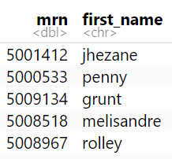
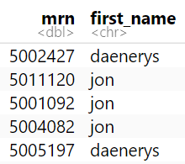
filter()
Filter to multiple matches
covid_testing %>%
filter(first_name %in% c("jon","daenerys"))

Slide 28
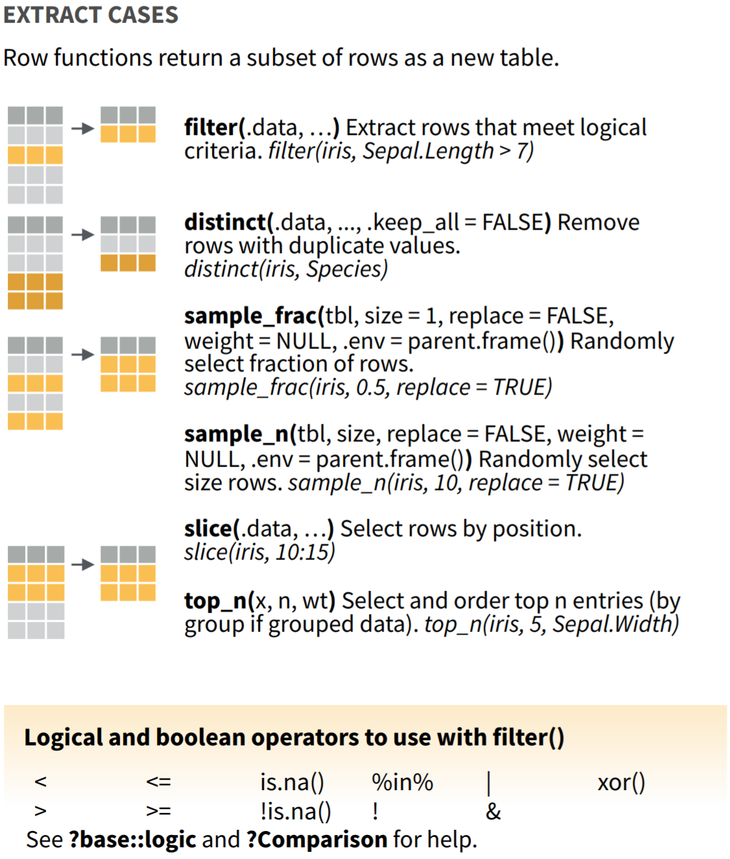
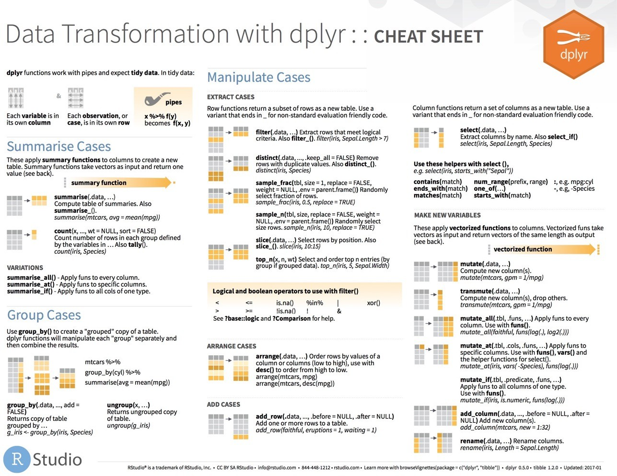
filter() variants
Notes:
Now filter() is only one of many functions that dplyr provides to allow you to extract the rows you want from your data. For a more comprehensive sampling see the Manipulate cases section on the dplyr cheatsheet.

Slide 29
Creating a New Column
Notes:
So now let's shift gears and discuss how we can derive new information from the raw data that we're provided

Slide 30
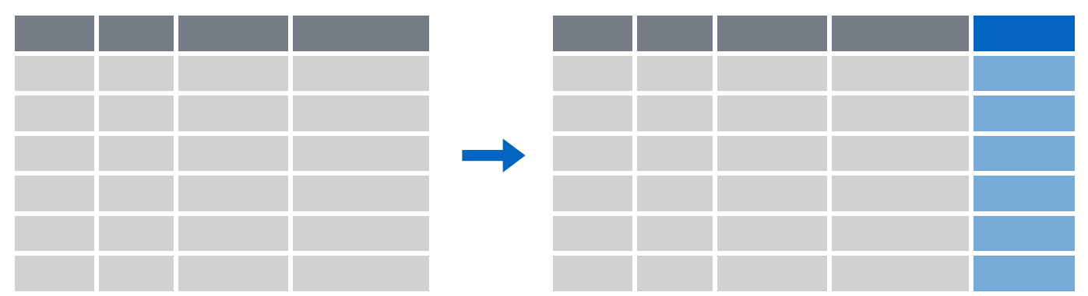
mutate()
Creating new calculated columns
= Number of rows
↑ Number of Columns
Notes:
The goal of mutate() is very simple. You’ll feed in your original data frame and it’s going to kick out the same data frame with one or more new columns tacked onto the end based on calculations that you specify.

Slide 31
mutate()
Creating new calculated columns
Covid_testing %>%
mutate(new_column = calculation)
function whose results will populate columns
name for new column
equals
Notes:
The syntax is going to look similar to the functions we saw earlier but with a small change. As before, the first argument is the original data frame, which gets piped into mutate. Then you specify the name of the new column you want to add, you use and equals sign to set it equal you a calculation. This calculation will be run on each row of your data frame and the result will populate each row of the new column.

Slide 32
mutate()
calculation can involve another column in the data frame
Creating new calculated columns
covid_testing %>%
mutate(c_r_tat_mins = col_rec_tat * 60)
mrn | col_rec_tat | rec_ver_tat
5000876 | 29.5 | 11.5
5006017 | 3.6 | 5
5001412 | 1.4 | 5.2
5000533 | 2.3 | 5.8
mrn | col_rec_tat | rec_ver_tat | c_r_tat_mins
5000876 | 29.5 | 11.5 | 1770
5006017 | 3.6 | 5 | 216
5001412 | 1.4 | 5.2 | 84
5000533 | 2.3 | 5.8 | 138
Notes:
Let’s look at an example. Currently our turnaround times are coded in hours but maybe we want to know the turnaround time in minutes.
What we could do is create a new column, called for instance “c_r_tat_mins ” and set that equal to 60 times the col_rec_tat column.
In this situation mutate() would perform that calculation on each row and place the result in a new column at the right most part of our data frame.

Slide 33
Your Turn 3
Create a new column using the mutate() function that contains the total TAT (sum of col_rec_tat and rec_ver_tat)
Notes:
OK lets do a little more work with turnaround times.
Say we're interested in the total TAT – how could you use mutate to derive a new column with the total TAT?

Slide 34
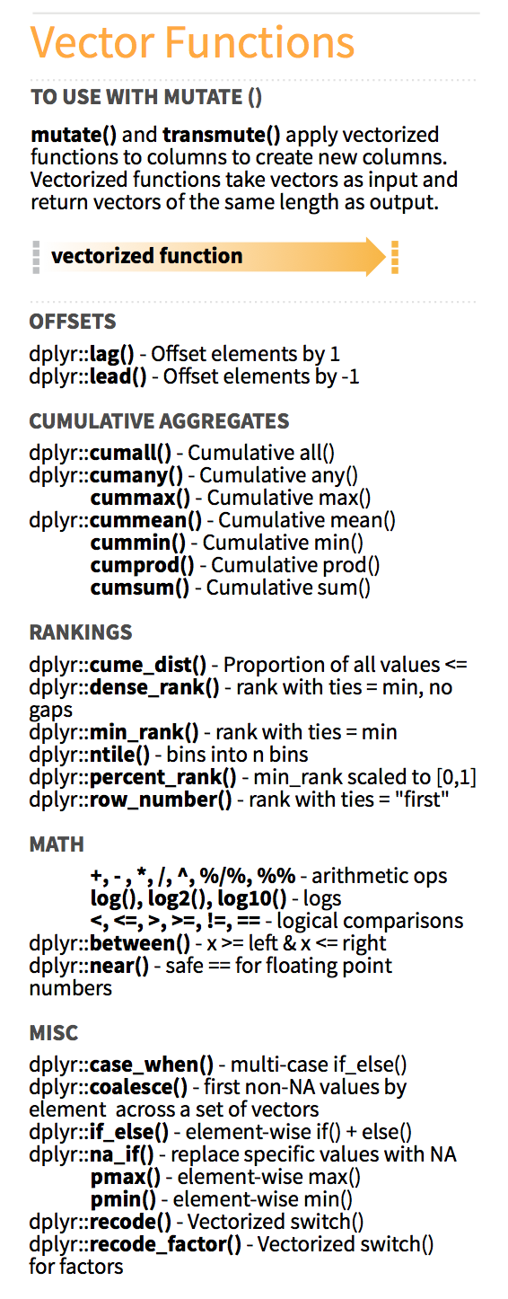
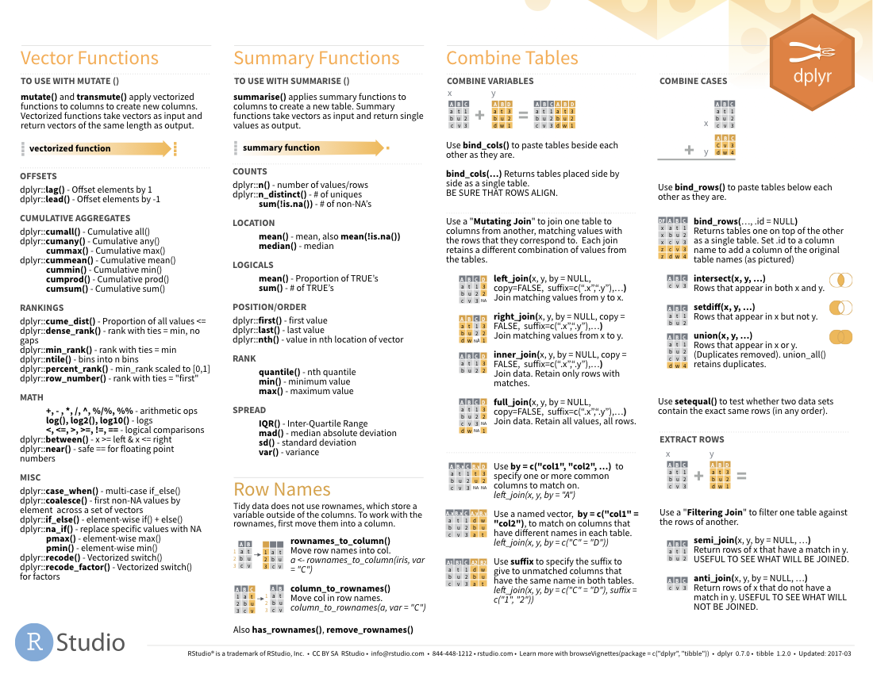

Functions to use in mutate()
on back
Notes:
There are tons of functions that you can use in the context of a mutate function, beyond just mathematics there are functions for ranking for creating cumulative aggregates, and many more found in the dplyr cheat sheet.

Slide 35
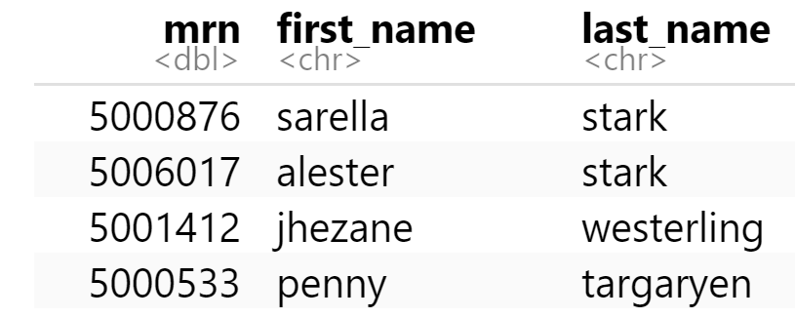
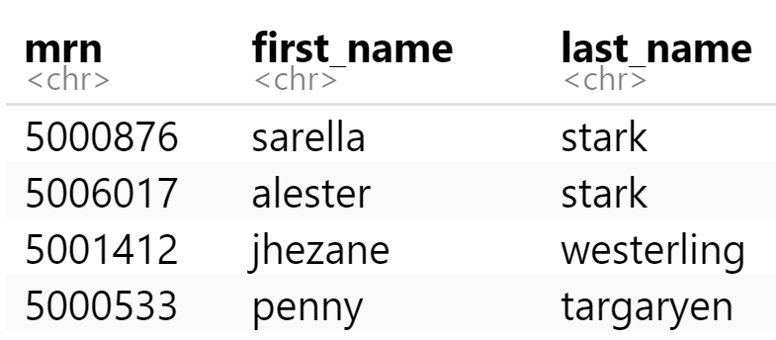
mutate()
Function to "coerce" one type of data into another type of data
Replacing columns
covid_testing %>%
mutate(mrn = as.character(mrn))

Slide 36
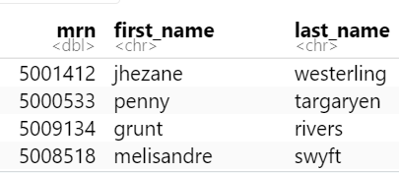
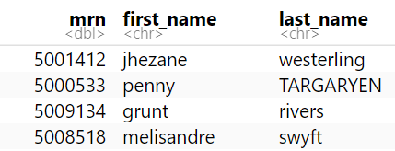
mutate()
Conditionally replacing values
covid_testing %>%
mutate(last_name = if_else(last_name=="targaryen", "TARGARYEN",last_name))

Slide 37
Piping Data from One Row to the Next
Notes:
The first set of functions we will explore will be ones whose primary goal is to extracting the data of interest from a large and often messy pile of data.
Reducing a dataset to a narrow subset of columns and rows is often the first step in an analysis.

Slide 38
Answering the age old lab question
There have been some complaints from a few inpatient units that turnaround times are longer than expected. You would like to a take a closer look at the tests that took longer than expected. For these inpatient samples turnaround times should rarely be longer than 18 hours, so you would specifically like to filter rows that are from inpatients and have a total turnaround time (collect to verify) of more than 18 hours.

Slide 39
Data Analysis Steps
tat_outliers <- filter(covid_testing, patient_class == ‘inpatient’)
Which patient locations sent COVID testing in the first 10 days of the pandemic?
tat_outliers <- mutate(tat_outliers,
total_tat = col_rec_tat + rec_ver_tat)
tat_outliers <- filter(tat_outliers, total_tat > 18)
1. Filter to extract a subset of inpatient results
2. Mutate to add a column for total turnaround time
3. Filter to select only the results with a total turnaround time greater than 18 hours
Notes:
For instance, in the context of the covid_testing data set, we might be interested in which clinical areas were the first to begin ordering our COVID test.
To accomplish this we're going to need to first filter to the rows that contain orders from the first 10 days of the pandemic. Then we'll select the column that contains the ordering location, and finally we'll arrange that column so that it's sorted by location.
→
Using the methodology we've learned so far this is how we would likely get this task done. We would first filter our original dataset specifying that we want pan_day, which contains the pandemic day of the order, to be less than or equal to 10. We'll assign that to a new object called day_10.
then we would select one column, the clinic_name column, from that dataset, we can overwrite and assign that back to day_10.
Finally we'll want to arrange that data set by the clinic_name column so we can get a more organized picture of the ordering locations.
Now if I put on my editorial hat I'd say that this is organized code, but it's not very efficient. We've written day_10 5 times here. We're creating the day_10 object and then overwriting it again and again. So is there a better way?

Slide 40
The Pipe Operator %>%
Passes result on left into first argument of function on right.
%>%
covid_testing
filter(____, patient_class == ‘inpatient’)
filter(covid_testing, patient_class == ‘inpatient’)
covid_testing %>% filter(patient_class == ‘inpatient’)
Notes:
This is exactly what the pipe operator does.
The pipe operator is this percent, greater than, percent symbol. It's a tool that we use to glue the pieces of our analysis together into one pipeline.
The pipe operator does something very simple but at the same time incredible useful. It takes the product of whatever is on the left and puts it into the function on the right.
So for example, the two lines of code in the gray box do exactly the same thing.
There are a whole bunch of reasons as to why this is a useful thing but for me, one of the most important reasons is that it turns computer code into something that is almost legible as human language.
You could essentially read the second line of code as “Take the covid_testing data frame, and then filter the pan_day column to rows that are less than or equal to 10.”

Slide 41
Data Analysis Steps
tat_outliers <- covid_testing %>%
filter(patient_class == ‘inpatient’) %>%
mutate(total_tat = col_rec_tat + rec_ver_tat) %>%
filter(total_tat > 18)
1. Filter to extract a subset of inpatient results
2. Mutate to add a column for total turnaround time
3. Filter to select only the results with a total turnaround time greater than 18 hours
Notes:
The code here is far more succinct. It's essentially self describing since it’s written in a sequential, essentially human readable format.
The pipe operator allows us to form chains that accomplish complicated data transformation operations but which are made up of very simple, self-contained, building blocks. So we're able to make something complex by joining together many simple elements that are easy to understand in isolation.
An additional benefit is that it makes it easier to actually write code because it's much easier to translate our thoughts into an analytical pipeline.

Slide 42
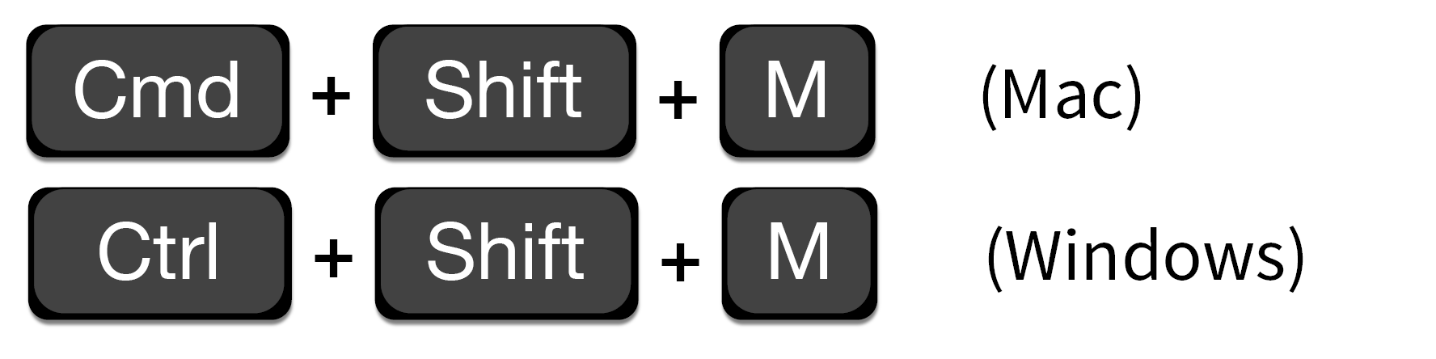
Shortcut to type %>%
Notes:
This pipe operator is going to be so useful to you you might as well learning a shortcut key that will type it out for you.
You can use either command, shift M on a mac or Ctrl shift M on a PC to save your fingers a few inches of movement.

Slide 43

Scene
The PICU would like a word with you because of a recent incident involving a delay in results for a patient who required a AGP
They had to wait over 10 hours before the procedure could begin
You decide to investigate… WITH DATA
Notes:
OK so let's put this to action. Imagine you get a call from the medical director of the PICU. She wants to know what's going on in your lab! She had to wait 10 hours for a COVID test result, meanwhile there was a patient who was awaiting an aerosol generating procedure!
You decide to investigate using the covid_testing data set

Slide 44
Your Turn 4
Use %>% to write a sequence of three functions that:
1. Filters to tests from the clinic (clinic_name) of "picu"
2. Adds a column with the total turnaround time (sum of col_ver_tat and rec_ver_tat)
3. Filters to include only the turnaround times greater than 10 hours
Using <-, assign the result to a new variable, call it whatever you want.

Slide 45
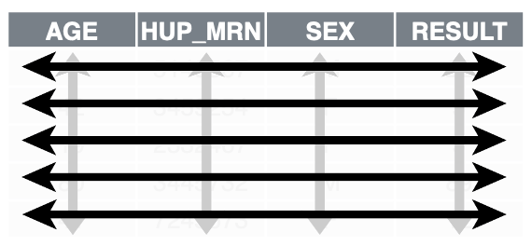
Recap
dplyr is a package that provides a grammar of data manipulation. Common operations include extracting a subset of your data set and adding new columns.
1. Fully utilizing dplyr requires a tidy data frame, in which each variable is in its own column, each observation is in its own row, each value is in its own cell;
2. The filter function allows you to extract a subset of your data using logical conditions
3. The mutate function allows you to add new columns to your data frame that can apply calculations across columns in your data frame
Notes:
To recap:
…

Slide 46
What Else?
Notes:
In this last part of this session, I want to show a few additional things you can do with ggplot, without going into much detail.

Slide 47
select()
Extract columns from a data frame
= Number of rows
↓ Number of Columns
Notes:
Here you see the graphical framework for how select works. You provide the raw data as the input in the form of a data frame.
It will extract the columns of your choosing and return these columns as a new data frame.
In the output, you will wind up with all the rows that you started with and just the columns defined in the select function.

Slide 48
select()
Extract columns from a data frame
select(data,... )
select(covid_testing, mrn, last_name)
data frame to transform
name(s) of columns to extract
(or a select helper) function)
dplyr function
data frame to transform
Notes:
So let's take a look at the syntax. You can see here that select() conforms to the syntax of all dplyr functions.
Select takes the starting data frame as its first argument. In this case it’s the "covid_testing" data frame.
After that it takes any number of additional arguments that specify the columns that you want to pick.
In it’s simplest form, those additional arguments will just be the names of the columns that you want to select. For example in this case we are indicating that we want to keep the mrn and last_name columns.
In very wide datasets, writing out the names of the columns you want just doesn’t scale so dplyr does have additional convenience functions that can help you succinctly identify the columns you want. We won't go over these together but they can be found in the data transformation cheat sheet in the appendix to your coursebook.

Slide 49
select()
Extract columns from a data frame by name
select(covid_testing, mrn, last_name)
covid_testing
description | department
PROTHROMBIN TIME | INTERNAL MEDICINE CLINIC
BASIC METABOLIC PANEL | INTERNAL MEDICINE CLINIC
THYROID STIMULATING HORMONE | ENDOCRINOLOGY CLINIC
T4, FREE | ENDOCRINOLOGY CLINIC
mrn | first_name | last_name | gender
5000876 | sarella | stark | female
5006017 | alester | stark | male
5001412 | jhezane | westerling | female
5000533 | penny | targaryen | female
mrn | last_name
5000876 | stark
5006017 | stark
5001412 | westerling
5000533 | targaryen
…
…
Notes:
So for example, if you were to run the code you see here, the snippet of the covid_testing data frame on the left would be accepted as input and a subset of it, the mrn and the last_name would be returned as output

Slide 50
select()
Extract columns from a data frame by name
select(covid_testing, -mrn, -last_name)
covid_testing
description | department
PROTHROMBIN TIME | INTERNAL MEDICINE CLINIC
BASIC METABOLIC PANEL | INTERNAL MEDICINE CLINIC
THYROID STIMULATING HORMONE | ENDOCRINOLOGY CLINIC
T4, FREE | ENDOCRINOLOGY CLINIC
mrn | first_name | last_name | gender
5000876 | sarella | stark | female
5006017 | alester | stark | male
5001412 | jhezane | westerling | female
5000533 | penny | targaryen | female
first_name | gender
sarella | female
alester | male
jhezane | female
penny | female
…
…
Notes:
Also by the way you if you put a little minus sign before the name of the column then select will actually EXCLUDE that column from the output.
So in this example we put a minus sign in front of column name mrn and last_name, and the snippet of covid_testing in the output only retains the first_name and gender columns

Slide 51
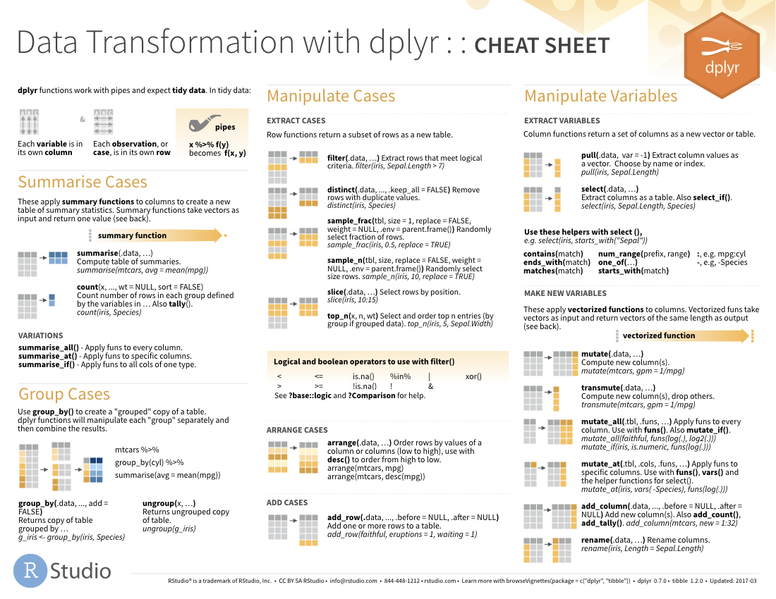
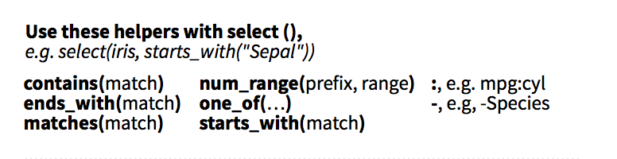
select() helpers
Notes:
I mentioned earlier that select actually has a bunch of helper functions that are there if you want to use a shortcut rather than writing out all the columns you want. So you can do term matching, you can select all columns between two columns, like the third through the tenth.
For a complete list, see the select() section on the dplyr cheatsheet in your appendix

Slide 52
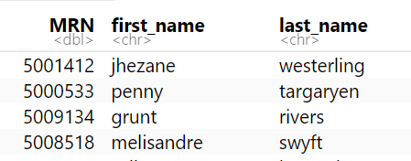
select()
Renaming columns
covid_testing %>%
select(MRN = mrn, first_name, last_name)

Slide 53
arrange()
Order rows by values in a column
= Number of rows
= Number of Columns
Notes:
Arrange doesn’t so much change your data as much as organize it
Often when exploring your data you’ll be interested in ordering the rows according to values in a specific column or columns. That’s what arrange() does. It let’s you focus on the most important parts of your data by rearranging and organizing it.

Slide 54
arrange()
Order rows by values in a column
arrange(data,... )
data frame to transform
name(s) of columns to arrange by
Notes:
arrange conforms to the general syntax of dplyr function. The data frame is your first argument. After that you can list one or more columns, each separated by a comma, to arrange the data frame by.

Slide 55
arrange()
Order rows by values in a column
arrange(covid_testing, first_name)
mrn | first_name | last_name
5000876 | sarella | stark
5006017 | alester | stark
5001412 | jhezane | targaryen
5000533 | penny | targaryen
mrn | first_name | last_name
5006017 | alester | stark
5001412 | jhezane | targaryen
5000533 | penny | targaryen
5000876 | sarella | stark
Notes:
In this example we are arranging covid_testing data frame by the first_name in ascending alphabetical order

Slide 56
arrange()
Order rows by values in a column
arrange(covid_testing, desc(mrn))
mrn | first_name | last_name
5000876 | sarella | stark
5006017 | alester | stark
5001412 | jhezane | targaryen
5000533 | penny | targaryen
mrn | first_name | last_name
5006017 | alester | stark
5001412 | jhezane | targaryen
5000876 | sarella | stark
5000533 | penny | targaryen
Notes:
By default arrange will order the rows from smallest to largest, from a to z, or from earliest date to latest depending on what type of data is in the column that we're arranging. We can reverse this by wrapping our column of interest in the desc() function.
So in this example our output is a data frame in ascending MRN order.

Slide 57
Pop Quiz
The default behavior of arrange() is to order from lower to higher values.
When might arrange() place "1000" before "50"?
Notes:
OK let's a quick thought experiment: by default, "arrange" will sort a column from lowest to highest value
If that's the case when might "arrange" actually place "1000" before "50"?
Correct – If we code 1000 and 50 as text rather as numerials then arrange is going to evaluate those values as if they are alphanumeric just looking at the first character since one is lower than five it'll place one before 5.

Slide 58

Transforming data
Extract variables with select()
Extract rows with filter()
Arrange rows, with arrange().
Add calculated columns with mutate()
Notes:
So far we’ve covered functions whose primary job is to reshape your data but don’t fundamentally tell you something about what’s inside of it.

Slide 59
Example: Applying the pipe
covid_testing %>%
filter(pan_day <= 10) %>%
select(clinic_name) %>%
arrange(clinic_name)
Notes:
The code here is far more succinct. It's essentially self describing since it’s written in a sequential, essentially human readable format.
The pipe operator allows us to form chains that accomplish complicated data transformation operations but which are made up of very simple, self-contained, building blocks. So we're able to make something complex by joining together many simple elements that are easy to understand in isolation.
An additional benefit is that it makes it easier to actually write code because it's much easier to translate our thoughts into an analytical pipeline.

Slide 60
Goal
Learn how to use dplyr to transform data frames
Appreciate the role of piping in facilitating data transformation
Objectives
List the major forms of data transformation implemented in dplyr
Extract columns meeting inclusion criteria from a data frame
Create new calculated columns not found in the original data frame
Use the pipe operator to pass the output of one function as an input to the next function

